Slide 1

Smart Apps
For
Smart Moms

Slide 2
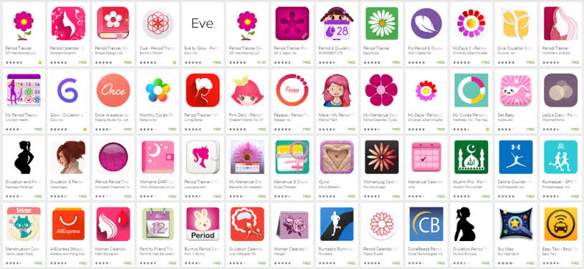
Menstrual Trackers
Notes:
LMP? Looking at Husbands face/Rummage thru Pandoras bag & fish out
Bunny/kitten-Pds& – app for each period

Slide 3
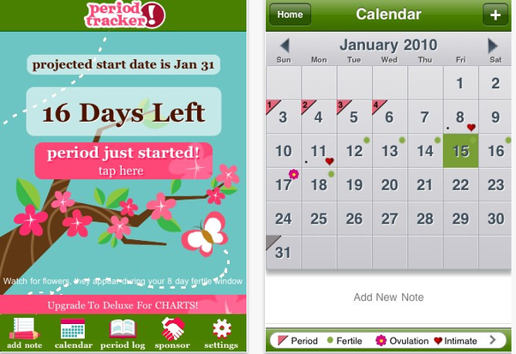
What does a Period App do?
Records Dates/ Duration/ Menstrual flow
Track Symptoms/Mood
Predicts next period
Pass word protection
Can sync with:
Calendar
Contraception app
Fertility app
Partner’s phone
Notes:
Prevent nosy parkers from peeping into menst statistics / Sync with partner so he is more kind on bad days

Slide 4
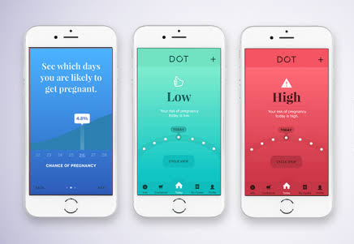
Contraception / Fertility Apps
Record of BBT
Cx Mucus
LH indicator
Daily Conception risk
93% effective with perfect use
-------------------------
Fertile period
Daily Fertility score
Notes:
Sync it with partner’s phone so he will decide whether to buy condoms or aphrodisiacs on his way back home

Slide 5
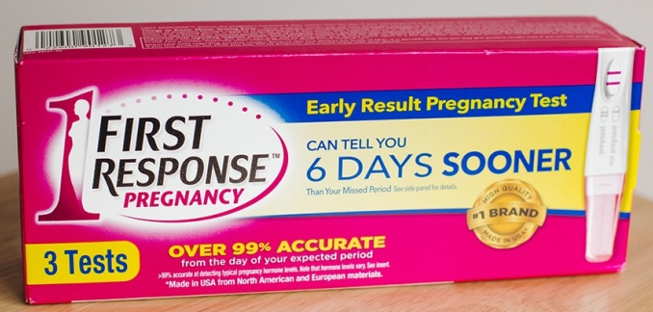
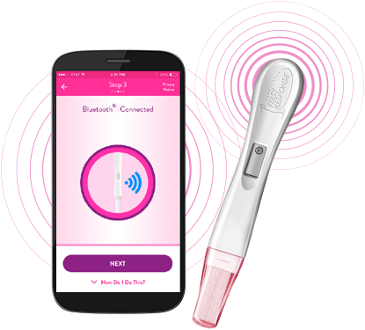
 | Blue tooth enabled pregnancy test
 | Positive just 6 days before the expected period
 | Over 99% accurate from the day of the expected period
Notes:
If contraception app fails or fertility app succeeds..

Slide 6
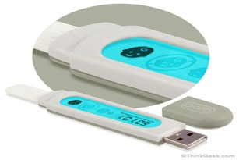
p-Teq USB Kit
Place a drop of urine on the stick
Insert USB connector into your computer
The power from USB port starts the electrospray ionization process, creating a spectrograph of the various masses
While you wait, you can read educational info or view entertaining videos or calming content or listen to Music!
The LCD display indicates positive results
No more confusing double lines
Bonus: it predicts the likelihood of multiple pregnancy and the estimated delivery date.
Notes:
3 minutes is a long time / for those who cant count up to 2

Slide 7
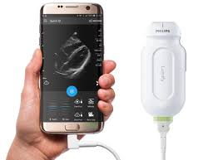
Mobile USG

Slide 8
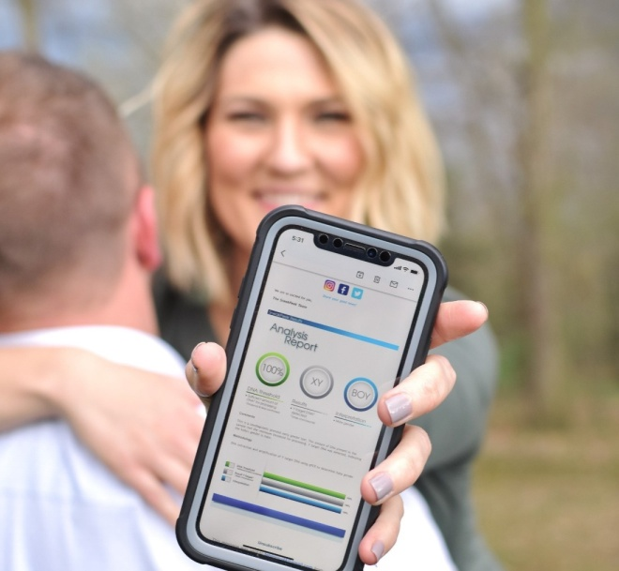
SneakPeek
It is a Home DNA blood test
It predicts the baby’s gender at 8 weeks with 99.1% accuracy
Earlier than NIPT or Chorion villus biopsy
Price starts at an affordable $79 (Rs 5700)
Int J Pregnancy & childbirth
Notes:
App for baby names / Sanskrit zodiac sign/numerology/ horoscope? or kannada with meaning

Slide 9
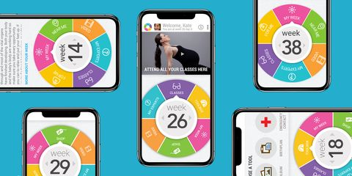
Pregnancy Apps

Slide 10
Prenatal Apps
Schedule appointments
Track medicines, doses and reminders
Maternal Vital signs
Nutrition advice & Recipes
Exercise
Relaxation
Pregnancy information
Monitor sleep
Conversation
Baby’s growth
3D images/videos
Fetal Movements
Fetal heart beats
Contractions
Medical assistance
Emergency alert
Shopping
Packing for Labour
Notes:
3D pics & videos

Slide 11
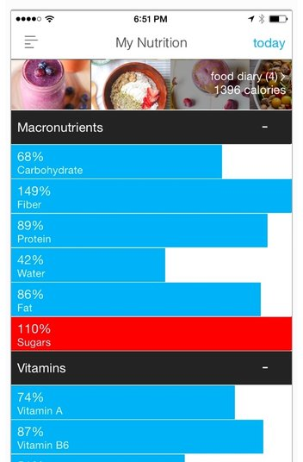
Nutrition apps
Assess intake of food, vitamins, minerals, antioxidants, omega fatty acids and DHA
Can track recipes and analyze diet for nutritional gaps every day
Suggest healthy recipes that match one’s needs and nutritional gaps

Slide 12
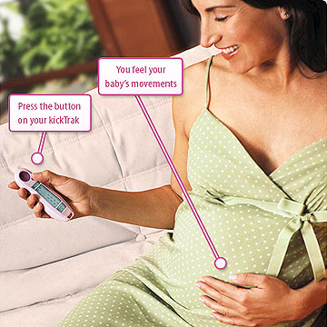
Track kicks
Device that tracks, counts and times movements
Serves as a pregnancy counter and keeps log for the last 99 days
Can be used to time contractions, frequency & duration when they begin
Differentiates false labour
Alert midwife/Obs
Recommended by ACOG

Slide 13
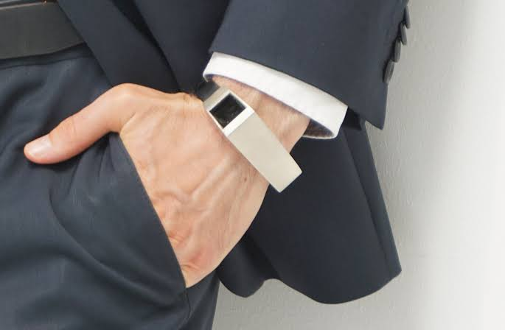
Why spare the fathers?
Notes:
Beep. The wife can get a kick out of disturbing him!

Slide 14
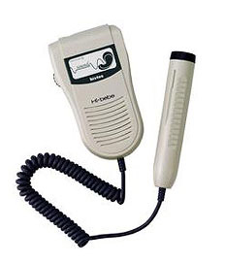
Fetal Doppler
Why wait a whole month between doctor visits to listen to the baby's heart rate?
This is an FDA-approved hand-held Doppler fetal heart rate monitor
You can play a fetal heart-rate concert for friends and family from afar

Slide 15
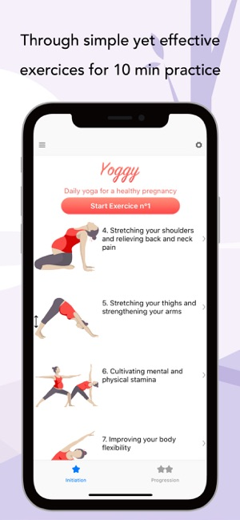

Prenatal and postnatal workouts

Slide 16
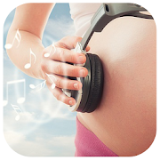
Relaxation
Babies can detect sounds inside the body by week 16 of pregnancy
By week 24, they can respond to voice
Classical music has been proven to be the music of intelligence
Listening pregnancy music can reduce stress and anxiety
Develops the baby's brain and makes it smarter.
Notes:
Captive audience

Slide 17
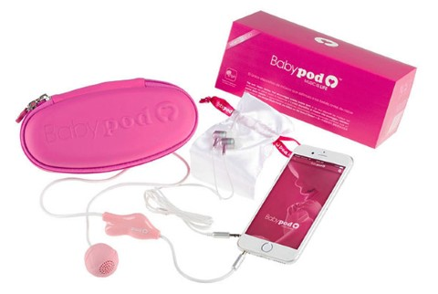
Since the uterus is a pretty soundproof environment, most outside noises, such as voices and music, hit baby's ears muffled and distorted
This tiny pink speaker is inserted vaginally
This device bypasses outside noise by bringing its speaker inside the mother
ACOG is skeptical about the pros & cons and the effect of noise
Publ J Ultrasound
Notes:
Transvaginal jugalbandi

Slide 18
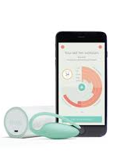
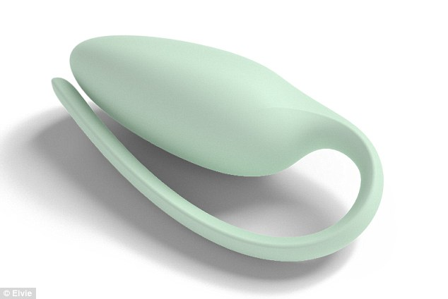
Kegel’s Pelvic Trainer

Slide 19
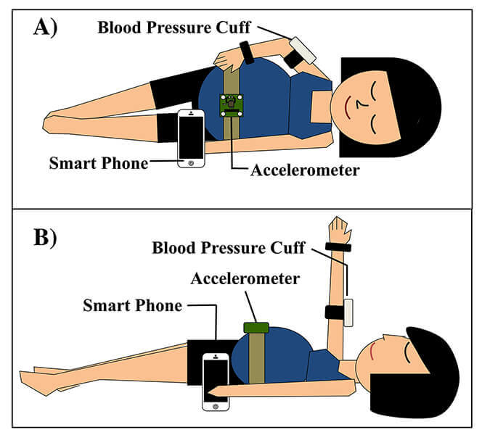
Detect Pre eclampsia
Uses an app with smart phones,
a conventional inflatable blood pressure cuff, and a wireless accelerometer (which measures body position)
Administers the supine pressor test that can identify the risk for preeclampsia
The test assesses blood flow through the kidney,
and 90 percent of women with a positive test eventually develop preeclampsia.
Craig Goergen of Purdue university

Slide 20
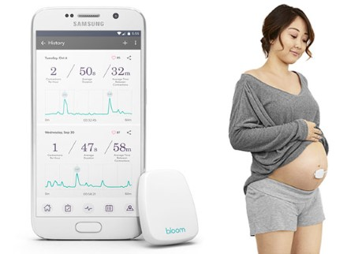
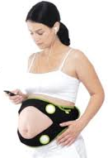
Contractions
The sensor attaches to abdomen like a Band-Aid or Belt
Detects the electrical signals in the uterus that control contractions, just like a heart monitor
The device then transmits the duration and frequency of contractions to The app via Bluetooth
She can watch the measurements change in real-time, view her contraction history or send the info to her doctor.

Slide 21








Slide 22
Brain Training app
The App provides for relaxed positive pregnancy, birth and parenting journey.
You’ll be guided through a uniquely tailored brain training program.
Simple effective breathing, mindfulness and medical hypnosis techniques that you’ll use long after your baby arrives.
Positive Birth
Positive Caesarean
Birth Rehearsal
Confident VBAC
Learn How to Push
Meditation
Rest & Sleep

Slide 23
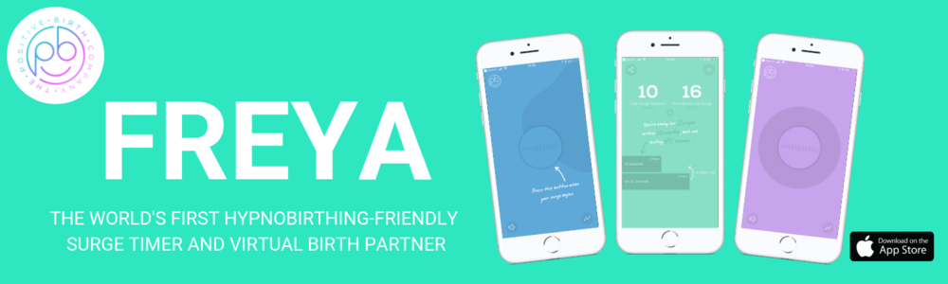
Freya is the world's first hypnobirthing-friendly contraction timer and virtual birth partner
It will coach you through each contraction with a simple breathing technique
It will help you to relax in between with positive affirmations, calming visualisations and guided relaxation.
It will also keep track of how frequently your contractions are coming and how long they are lasting.
It will even let you know when to contact your midwife!

Slide 24
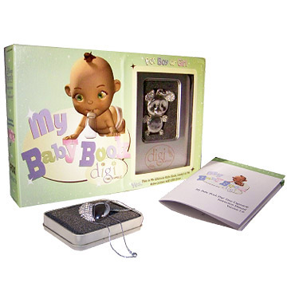
Time Capsule
Silver and diamond-covered USB necklace documents your and your child's life (journal entries, photos, and videos up to age 5).
When plugged into your computer, automatically accesses the time capsule software.
you can keep them nicely tucked away around your neck or sitting by your computer
And the necklace serves as a great keepsake to be passed on to your child later on in life.

Slide 25
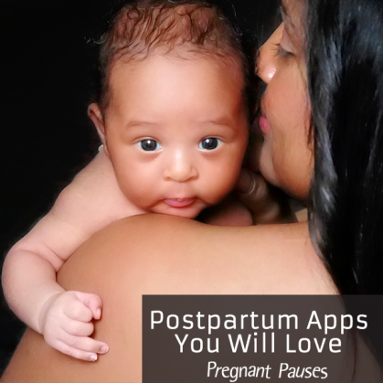
Postpartum package
A comprehensive guide to the fourth trimester including a series of video workshops
Keep a daily log of your postpartum fitness, behavior and feelings.
Based on the input information, advice is given on how to feel better, how to take care of the baby with confidence.

Slide 26

Prenatal &
Postpartum Depression
Apps to engage, predict & identify women at risk for depression or anxiety or psychiatric illness during pregnancy and the postpartum period
This will facilitate appropriate referral

Slide 27
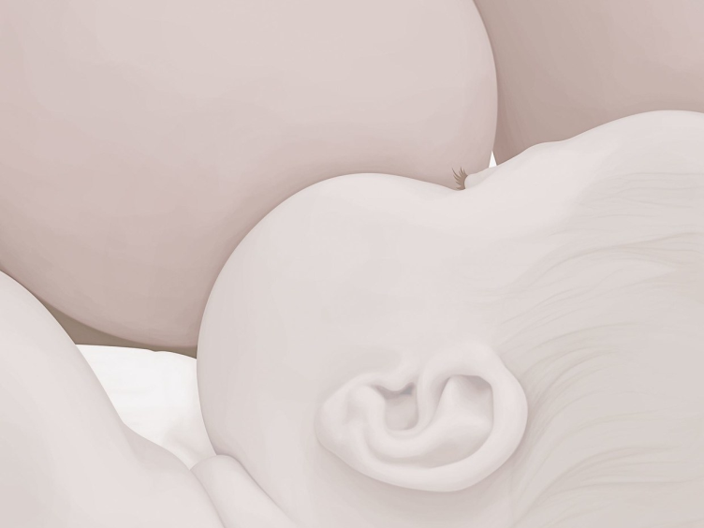
Breast feeding apps
Breast feeding techniques & frequency
Common issues & remedies
Help ‘Let down reflex’ by displaying pictures of your baby and play sounds mimicking a hungry child, to get the mammary glands working!

Slide 28
